Slide 1
OMIS 661 – Business Intelligence Applications and Tools Project
Devaki Machineni: Z1947232
November 28, 2022

Slide 2
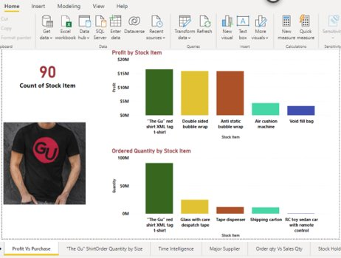
Profit Analysis
Analysis: Out of the total 90 distinct stock items, “The GU” red tag shirt is the most profitable one. The purchase quantity also shows the highest ordered product is the t-shirt. But the purchase quantity is significantly high compared to sales quantity.
Recommendation: Wide World Importers (WWI) needs to develop a strategy, like promotion or a re-design negotiation with suppliers to release huge on hand inventory.

Slide 3
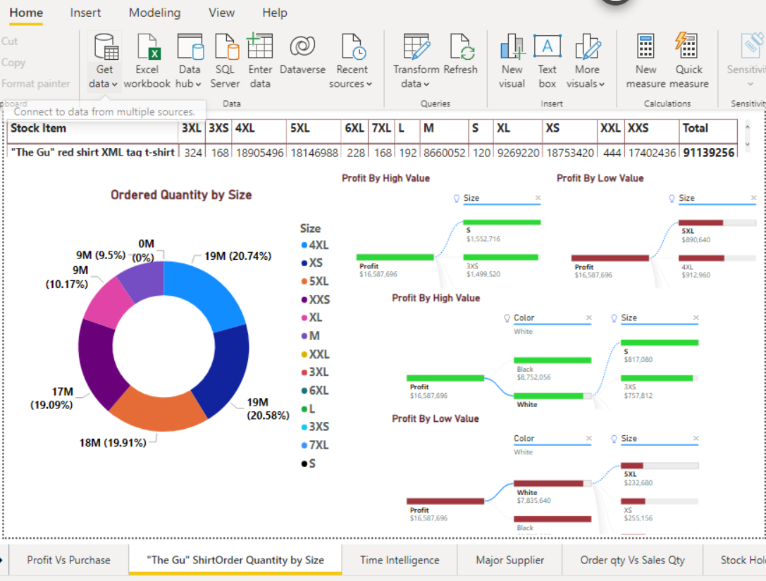
Cont…
Analysis: The size of the shirt have a positive contribution to profit. Profit is more likely to increase when the t-shirt size is Small. But the order items show significantly low value for size S. In contrast the least profitable t-shirt size is purchased in high quantity.
Recommendation: WWI should buy and sell more S size shirts as the profit is likely to increase with S size shirt. Also, the purchase of the 5XL t-shirt need to be discontinued.

Slide 4
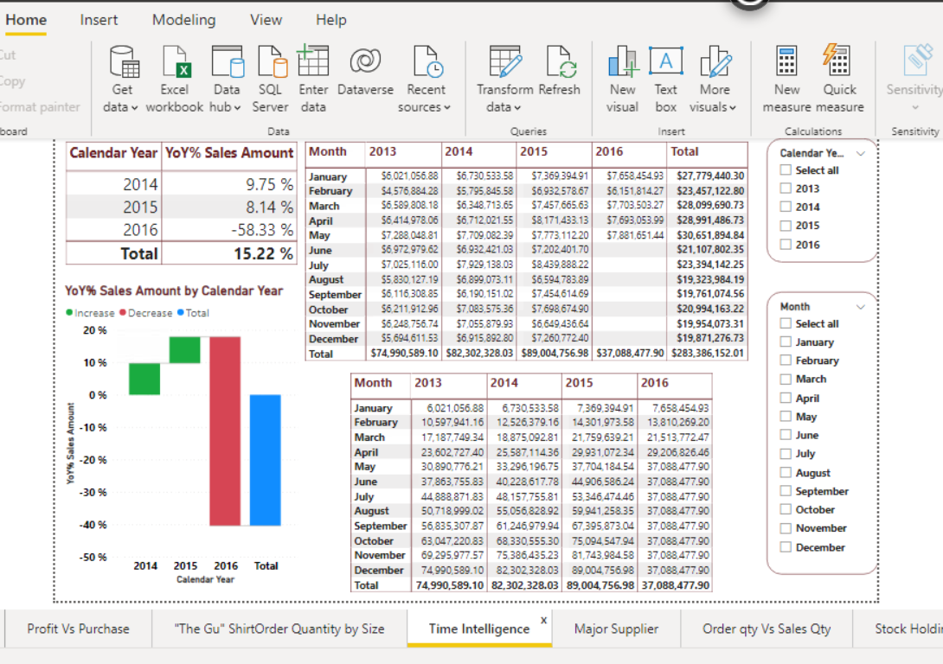
Sales Analysis
Analysis: There is a steady sales growth between the years. Also, the sales amount is consistent over the months in each year. Slight decline in sales is observed during the first quarter of 2016.
Recommendation: Holiday seasons are characterized by high sales of stock items imported and distributed by WWI. The company can use Holiday promotions to increase sales amounts during the month of November, December, May, July.

Slide 5
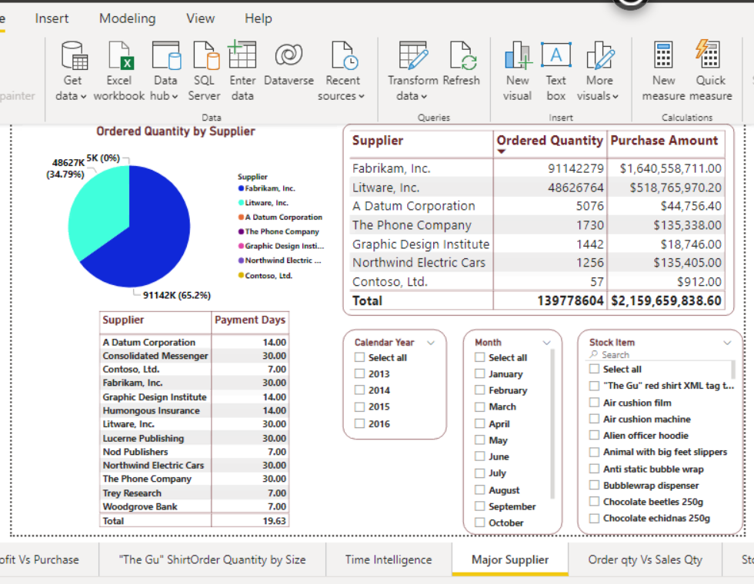
Suppliers Analysis
Analysis: WWI dominantly imports stock items from Fabrikam Inc and Litware Inc.
Recommendation: WWI should consider diversifying suppliers as a risk minimization strategy. The company can also use an advantage to negotiate payment days with these suppliers to gain more time to use cash flows for other business expansion ideas.

Slide 6
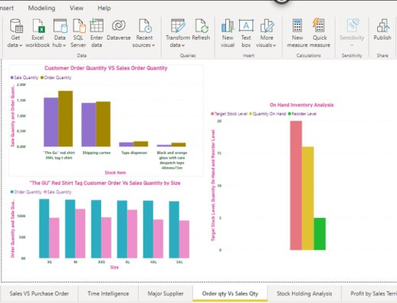
Customer Order Vs Sales
Analysis: For certain stock items, the customer-ordered quantity is higher than the sales-order quantity. It means a few items are under stock and hence sales are not happening for those items which the customers ordered.​
Recommendation: The company has to check on those items and increase their stock to the required levels so that the sales order quantity will increase.

Slide 7
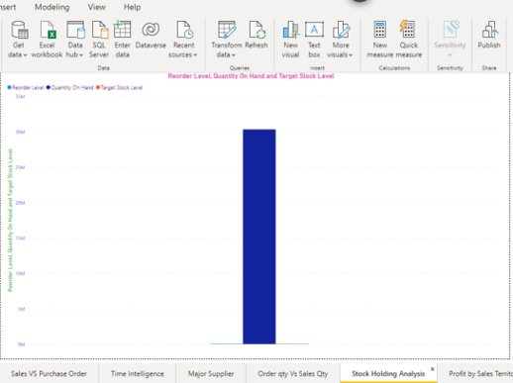
Inventory Analysis
Analysis: Inventory quantity on hand is very much higher than the target level. It is triggered by the reorder level which might be automatic which is causing huge inventory levels. ​
Recommendation: The company has to check the inventory on hand levels for each stock item. If this measure is not taken, the company will result into huge debts due to high inventory than the required stock.​

Slide 8
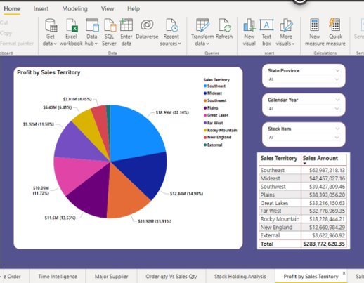
Profit by Sales Territory
Analysis: Highest record of both profit and Sales Amount is from the Southeast sales territory. The difference between the top first and second profit/sales amount considerably high. ​
Recommendation: WWI need to do a market analysis to identify new market opportunities and new approaches to increase sales to the other sales territories.

Slide 9
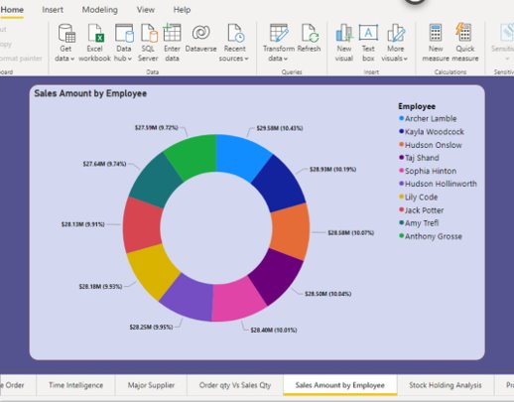
Sales by Employee
Analysis: The comparison of the sales amount by employees shows that there is no major difference between salespersons, or the differences are highly insignificant. ​
Recommendation: WWI can use talents and improve sales by introducing a reward and recognition approach to highly performing salespersons.

Slide 10
Thank you!

